Slide 1
Predicting Taxi Ride Prices
Sven Durchholz
Leonard Schmischke

Slide 2
Why Data Science?
“The demand for data scientists is increasing so quickly, that McKinsey predicts that by 2018, there will be a 50 percent gap in the supply of data scientists versus demand.” – The Alexa Blog (http://blog.alexa.com/know-data-science-important/)

Slide 3
What is the data about?
Rides of Yellow Cabs (taxis) in New York
June 2016
~11 million rides
19 features
geolocation, time and date, distance, fares, …
14 in test data set (+id)
Fare_amount
Extra
MTA
Tip_amount
Total_amount

Slide 4
What is the data about?
Six rate codes:
Standard metered fare
$2.5 initial charge
When faster than 6mph: 50ct per 0.2 mile
When slower than 6mph: 50ct per minute
50ct overnight surcharge (8pm to 6am), $1 rushhour surcharge (4pm to 8pm on weekdays)
Extra charges: 30ct improvement surcharge, up to 50ct MTA surcharge, tolls
Tips when paying with credit card (payment_type 2)
http://www.nyc.gov/html/tlc/html/passenger/taxicab_rate.shtml

Slide 5
What is the data about?
Six rate codes:
Standard metered fare
Trips to/from JFK Airport
$52 flat
$4.5 rush-hour surcharge (4pm to 8pm on weekdays)
Extra charges: 30ct improvement surcharge, up to 50ct MTA surcharge, tolls
http://www.nyc.gov/html/tlc/html/passenger/taxicab_rate.shtml

Slide 6
What is the data about?
Six rate codes:
Standard metered fare
Trips to/from JFK Airport
Trips to Newark Airport
Uses standard metered fare (everything from 1 applies)
$17.50 Newark Surcharge
http://www.nyc.gov/html/tlc/html/passenger/taxicab_rate.shtml

Slide 7
What is the data about?
Six rate codes:
Standard metered fare
Trips to/from JFK Airport
Trips to Newark Airport
Out of Town Trips (to/from Manhattan from/to Westchester & Nassau Counties)
In town: standard metered fare (see 1)
Out of town: doubled standard metered fare
All charges apply
http://www.nyc.gov/html/tlc/html/passenger/taxicab_rate.shtml

Slide 8
What is the data about?
Six rate codes:
Standard metered fare
Trips to/from JFK Airport
Trips to Newark Airport
Out of Town Trips (to/from Manhattan from/to Westchester & Nassau Counties)
Negotiated Trips (everywhere else)
Flat rate is negotiated before the ride
50ct MTA and 30ct improvement surcharge apply
http://www.nyc.gov/html/tlc/html/passenger/taxicab_rate.shtml

Slide 9
What is the data about?
Six rate codes:
Standard metered fare
Trips to/from JFK Airport
Trips to Newark Airport
Out of Town Trips (to/from Manhattan from/to Westchester & Nassau Counties)
Negotiated Trips (everywhere else)
Group rides
Two possible routes with specific pickup and dropoff locations
Flat price per person
http://www.nyc.gov/html/tlc/html/passenger/taxicab_rate.shtml

Slide 10
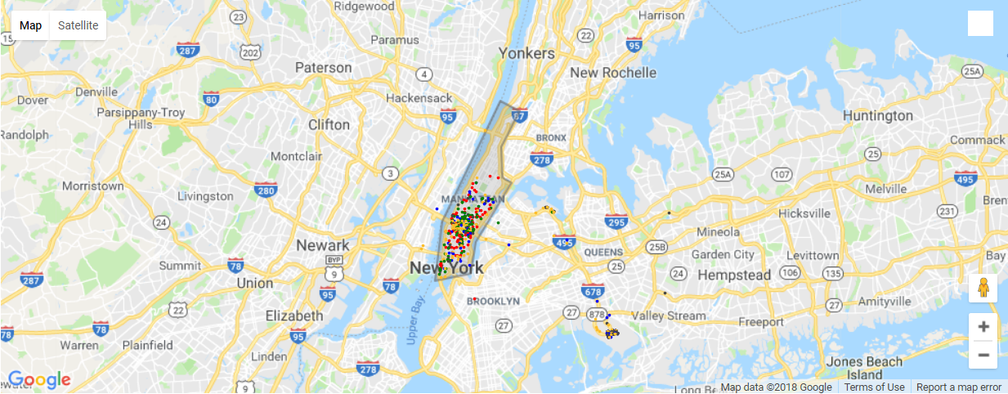
Pickup-locations per ratecode
Standard Rate (1)
JFK (2)
Newark (3)
Out of Town (4)
Negotiated (5)

Slide 11
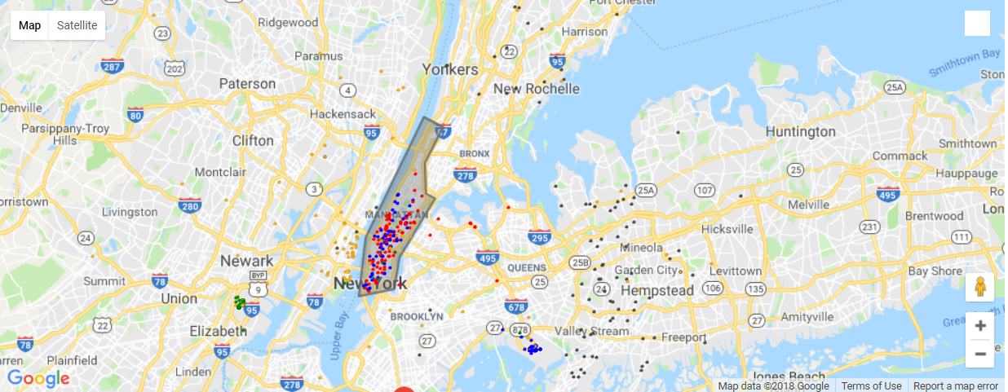
Dropoff-locations per ratecode
Standard Rate (1)
JFK (2)
Newark (3)
Out of Town (4)
Negotiated (5)

Slide 12
EDA

Slide 13
Outlier detection
Invalid values
RatecodeIDs
Improvement surcharge
mta_tax (either 0 or .5)
Extra
date
Negative Values
Total amount must be sum of all other costs

Slide 14
Outlier detection
Drop unreasonable high values
Distance > 100 miles
Fare amount > $400
Get tip percentage
Drop > 50%
Get duration
Drop < 30 seconds
Drop > 3 hours
Drop Dates outside June 2016

Slide 15
Outlier detection
ERSETZEN? EXTRAS 1.5 NOCH MIT DRIN

Slide 16
Outlier detection

Slide 17
Outlier detection

Slide 18
Outlier detection
Which features are important
Why
Impact on modeling
New features?
Avg_speed
Traffic per hour (only if important)
What did not work?

Slide 19
Fare amount prediction

Slide 20
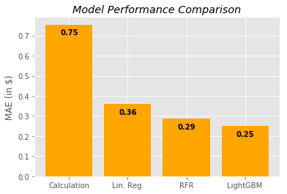
Fare amount prediction

Slide 21
Modelling approach

Slide 22
Modelling approach

Slide 23
Modelling approach
Can be used for rate code 1 and 3
Rate code 2?
Rate code 5?
Rate code 4?

Slide 24
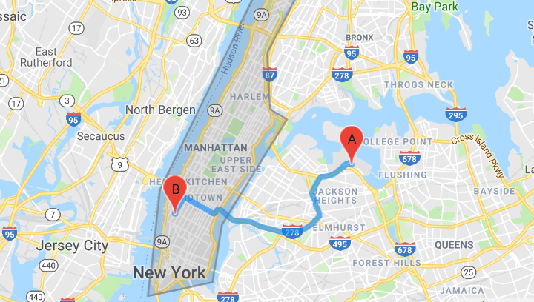
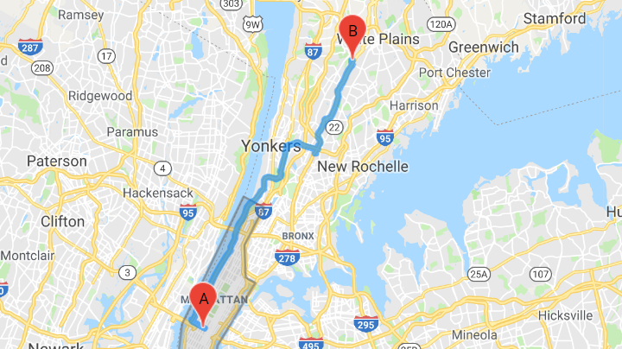
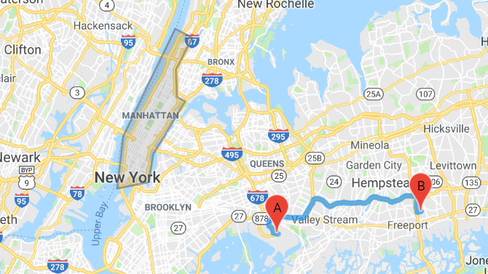
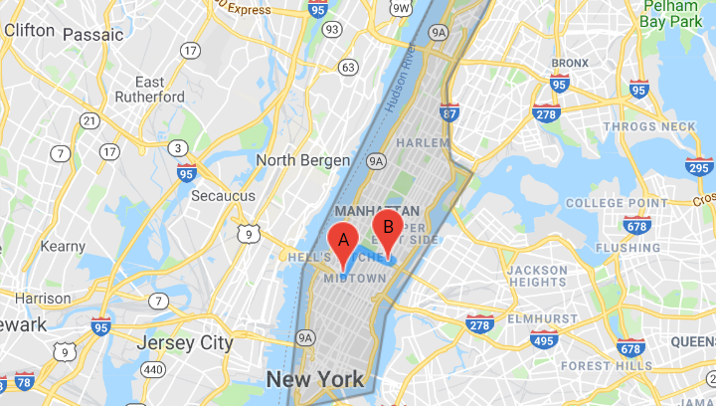
Rate code 4 – „Out of Town Trips“
Entering the city
Leaving the city
Only outside of the city
Only inside the city

Slide 25
Algorithm selection

Slide 26
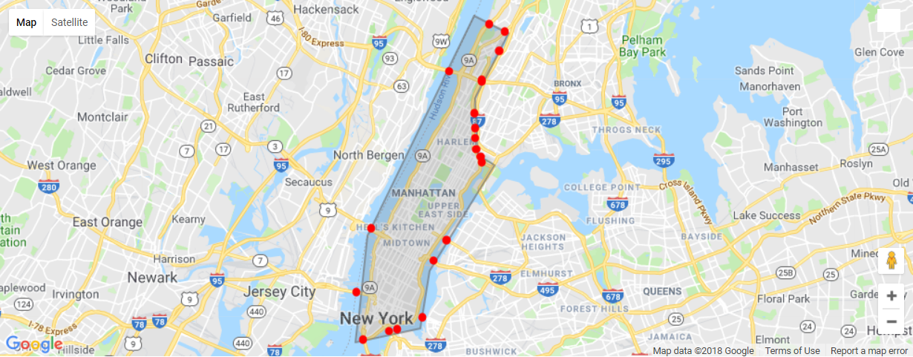
Bridge/tunnel positions

Slide 27
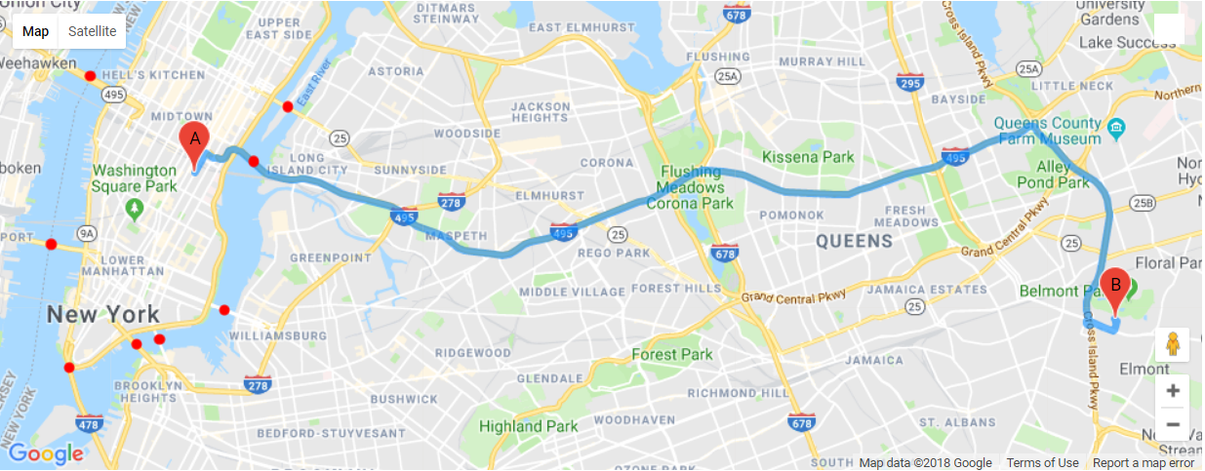
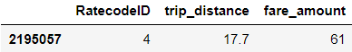
Bridge calculations (2195057)

Slide 28
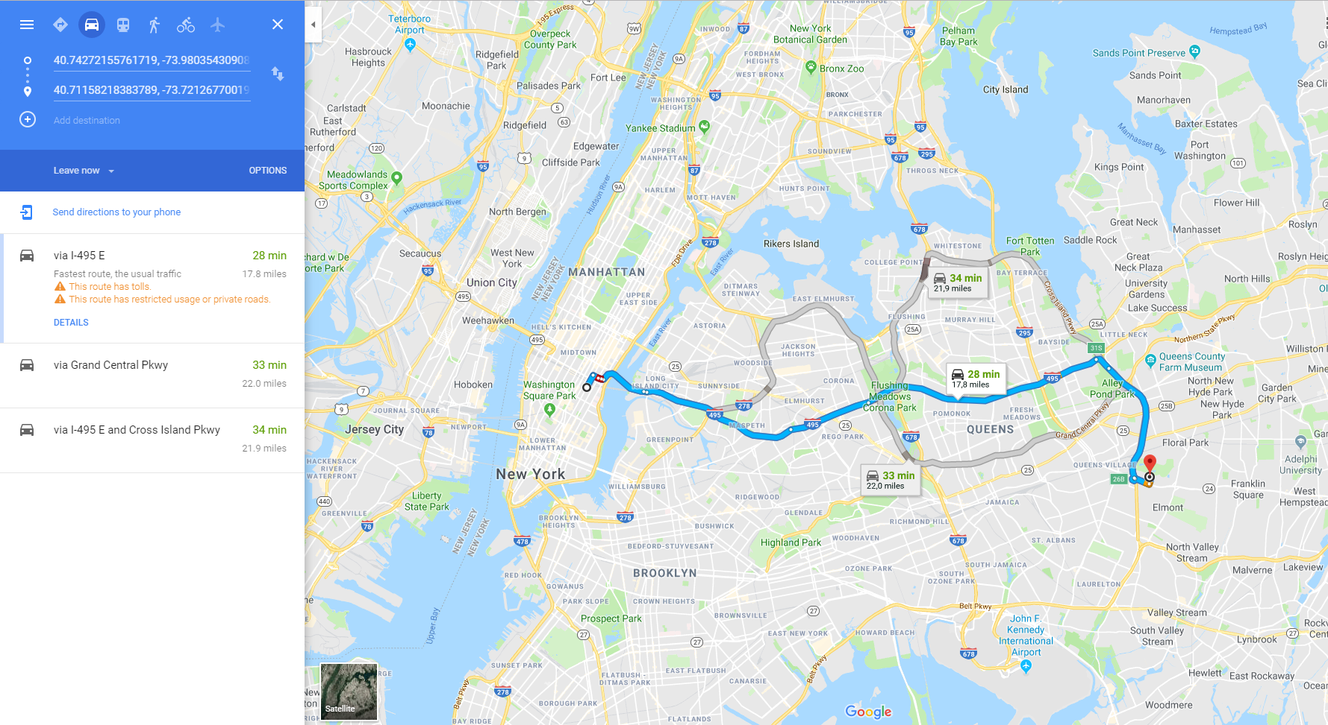
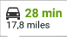
Bridge calculations (2195057)

Slide 29
Bridge calculations (2195057)
A
B
C

Slide 30
Bridge calculations (2195057)
A
B
C

Slide 31
Bridge calculations (2195057)
0.87 miles
12.9533 miles

Slide 32
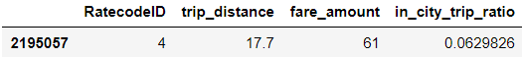
Bridge calculations (2195057)
0.87 miles
12.9533 miles

Slide 33
Bridge calculations (2195057)
0.87 miles
12.9533 miles

Slide 34
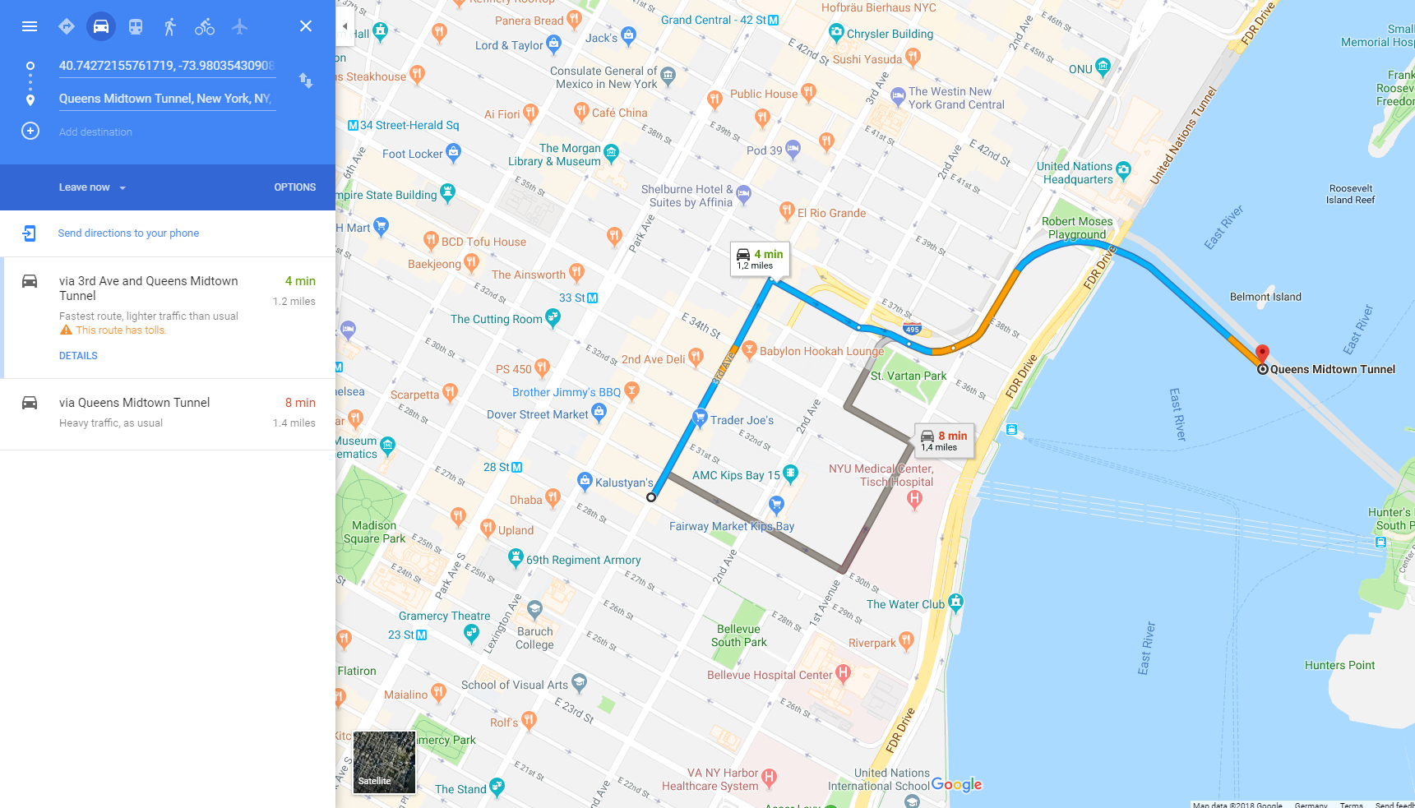
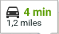
Bridge calculations (2195057)

Slide 35
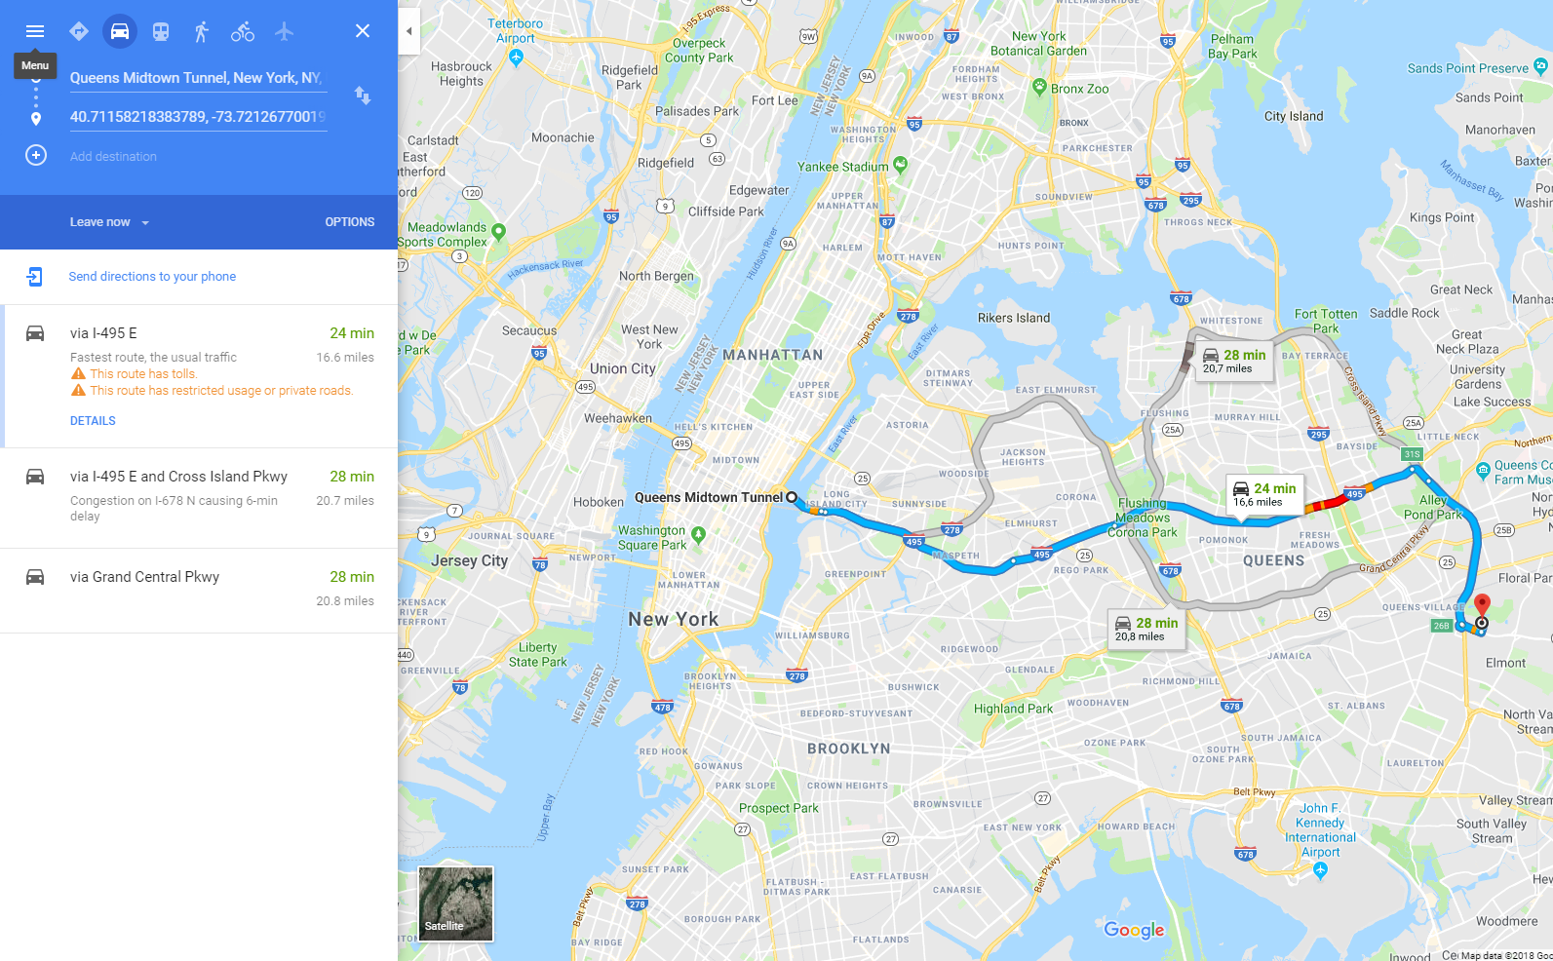
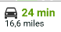
Bridge calculations (2195057)

Slide 36
Problems
Assumption 1: Bridge that minimize air-line distance is actually used
Different route
Non-linear route
Assumption 2: air-line distance ratio represents real inner-city to outer-city trip distance ratio
Different shape of route in city vs out of city
Extra destinations possible

Slide 37
Extra

Slide 38
MTA

Slide 39
Tips

Slide 40
Evaluation
In Anhang: Resid plots und Err-Hist plot für jedes Modell

Slide 41
Retrospective
Use districts via geolocation shapefiles
For tip prediction
For MTA tax calculation
Outlier detection
Use googlemaps routes
External data?
Traffic data
Weather data
More knowledge about LightGBM parameter tuning
Try different algorithms (XGBoost?)

Slide 42
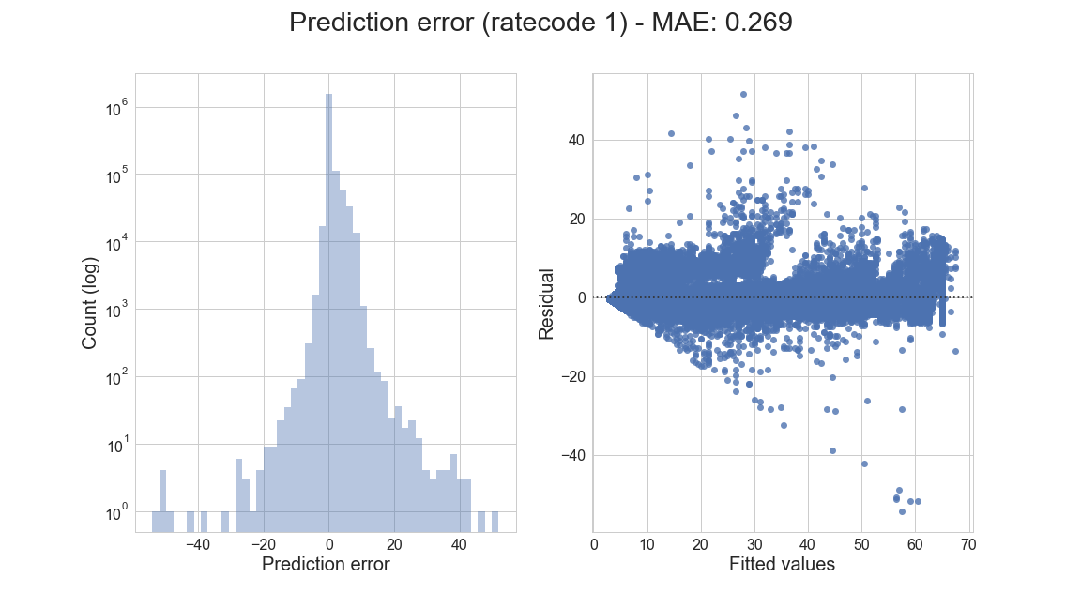
Ratecode 1 model evaluation

Slide 43
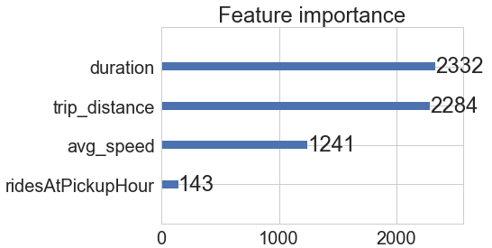
Ratecode 1 model evaluation

Slide 44
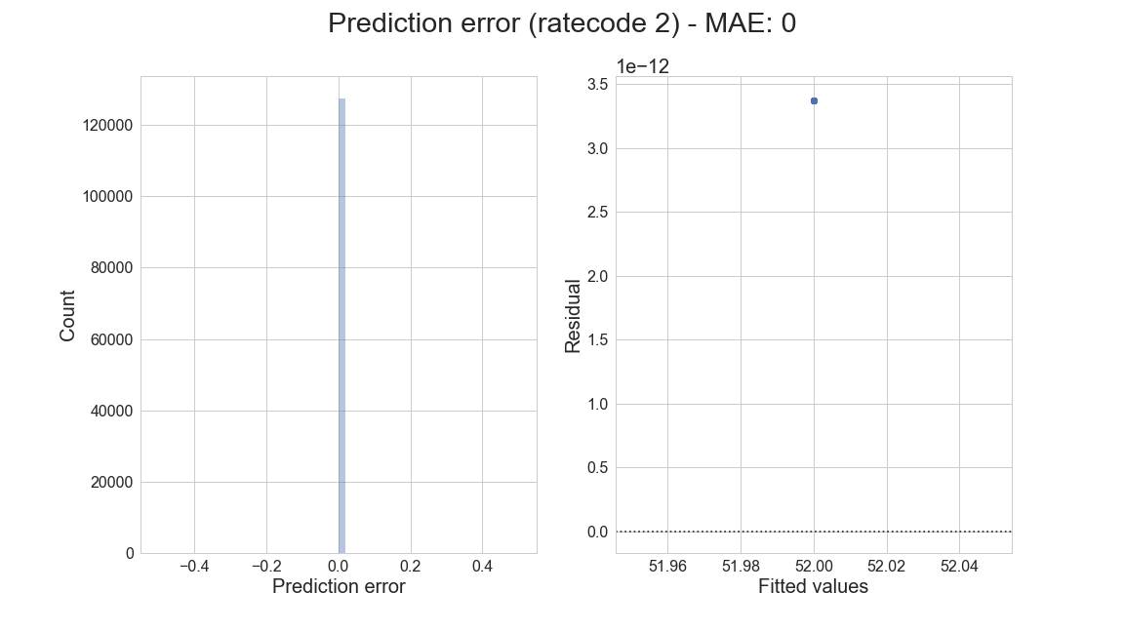
Ratecode 2 model evaluation

Slide 45
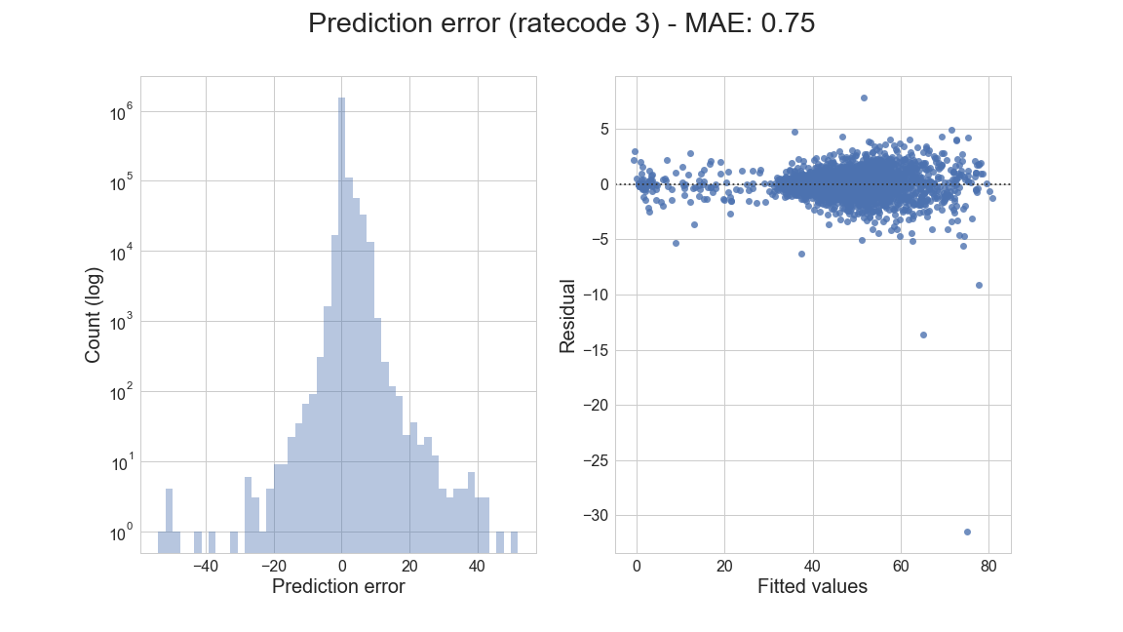
Ratecode 3 model evaluation

Slide 46
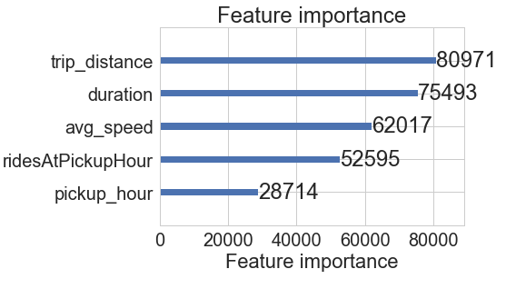
Ratecode 3 model evaluation

Slide 47
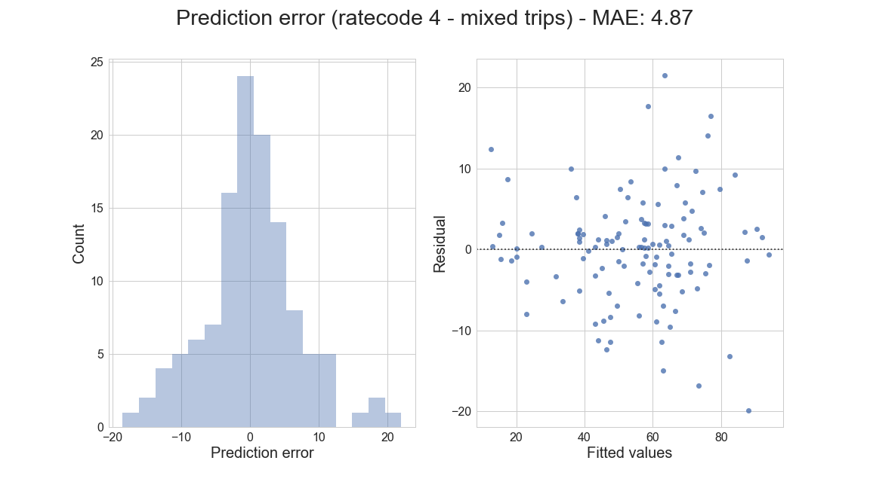
Ratecode 4 model evaluation

Slide 48
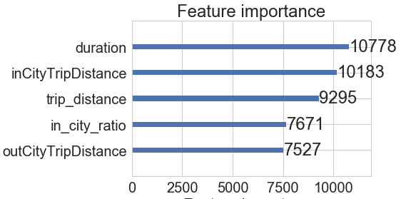
Ratecode 4 model evaluation

Slide 49
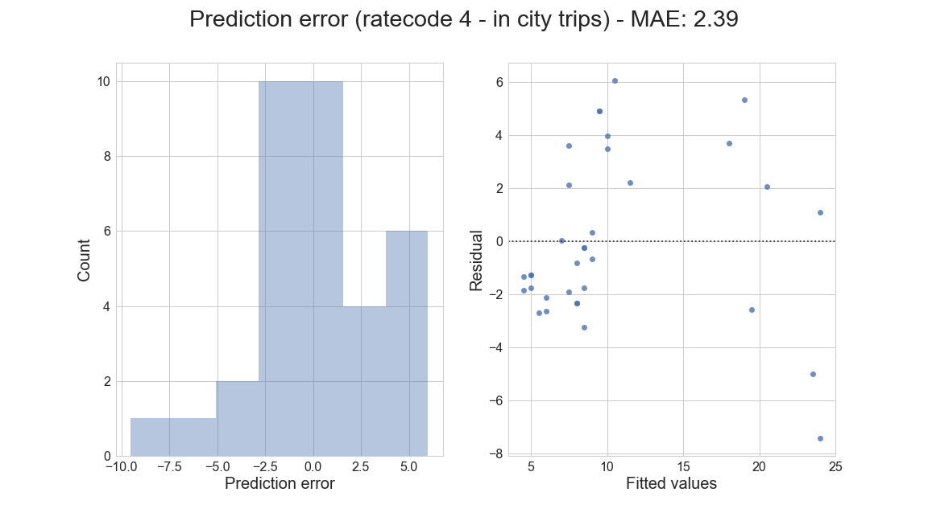
Ratecode 4 model evaluation

Slide 50
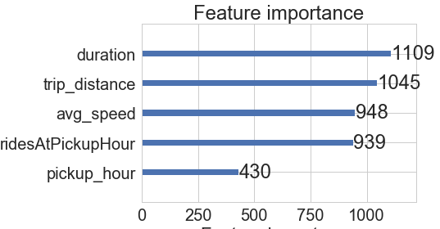
Ratecode 4 model evaluation

Slide 51
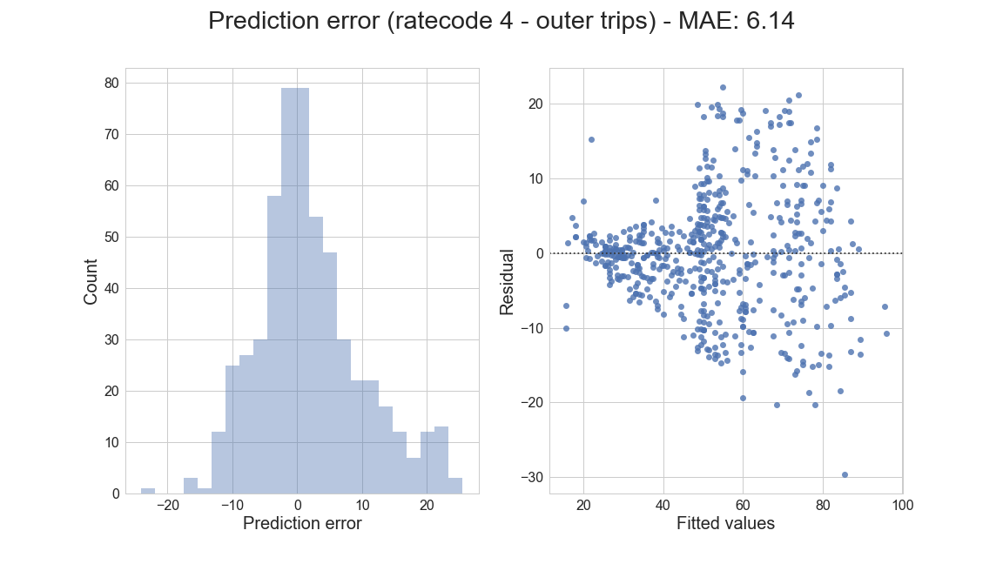
Ratecode 4 model evaluation

Slide 52
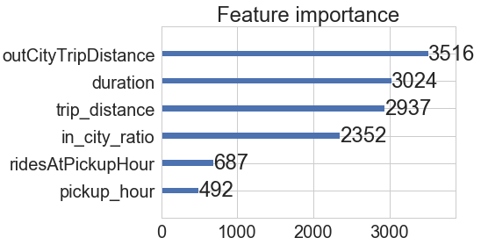
Ratecode 4 model evaluation

Slide 53
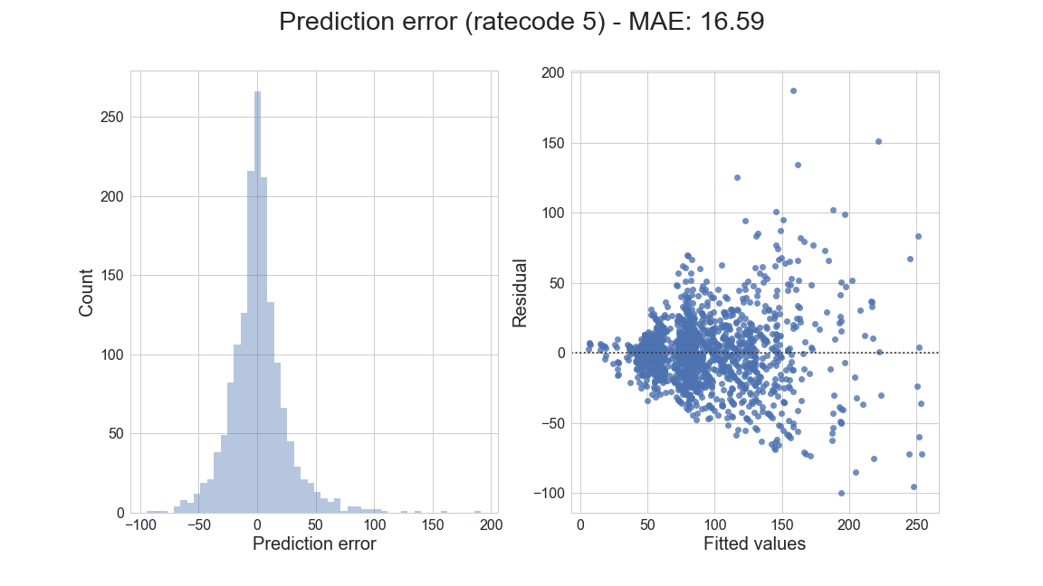
Ratecode 5 model evaluation

Slide 54
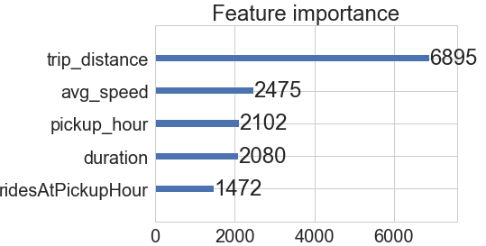
Ratecode 5 model evaluation

